Slide 1
FLASHFORGE AI~ An Intelligent Generative AI-Powered Flashcard Generator
CAPSTONE PROJECT
Presented By:
Student Name- DEEPANSHI AGARWAL
College Name- MANIPAL UNIVERSITY, JAIPUR
Department - BBA
4. AICTE ID- STU6a68a895919291785243797

Slide 2
OUTLINE
Problem Statement (Should not include solution)
Proposed System/Solution
System Development Approach (Technology Used)
Algorithm & Deployment
Result
Conclusion
Future Scope
References

Slide 3
Problem Statement
Students often spend a significant amount of time creating revision notes and flashcards manually from lengthy study material. Converting large amounts of text into concise questions and answers can be time-consuming and repetitive. Students may also find it difficult to identify the most important concepts from their notes for effective revision.
Problem: There is a need for a simple and efficient way to convert study material into useful flashcards for quick revision.

Slide 4
Proposed Solution
The proposed system uses Generative AI to automatically create flashcards from user-provided notes or study material:-
Key components:
1. User Input The user enters notes or study material into the application.
2. Prompt Generation The Python program converts the user's notes into a structured prompt requesting questions and answers.
3. AI Generation Google Gemini processes the prompt and generates relevant flashcards.
4. Output Display The generated questions and answers are displayed through a Streamlit interface.
5. User Interaction The user can enter different topics and generate flashcards for revision.

Slide 5
System Approach
Technology Used:
Python — Main programming language
Streamlit — Used to create the web interface
Google Gemini API — Used for AI-based flashcard generation
Google Generative AI Python Library — Used to communicate with Gemini
VS Code — Development environment
System Requirements
Software:
Python
VS Code
Streamlit
Google Generative AI library
Internet connection
Gemini API key
Input: User-provided notes or study material.
Output: AI-generated questions and answers in flashcard format.

Slide 6
Algorithm & Deployment
User Input: The user enters notes or study material into the Streamlit text area.
Prompt Generation: Python takes the entered notes and creates a structured prompt asking Gemini to generate 5 flashcards with questions and answers.
AI Generation: The prompt is sent to the Google Gemini model through the Generative AI API.
Response Processing: Gemini generates the flashcards, and Python receives the generated response.
Output Display: Streamlit displays the generated questions and answers on the user interface.
▪ Deployment:
The application is developed using Python and Streamlit.
It runs locally through localhost:8501 during development.
The application can be deployed using Streamlit Community Cloud to create a shareable web link.
User Input → Streamlit → Python Prompt → Gemini AI → Python Response → Streamlit Output

Slide 7
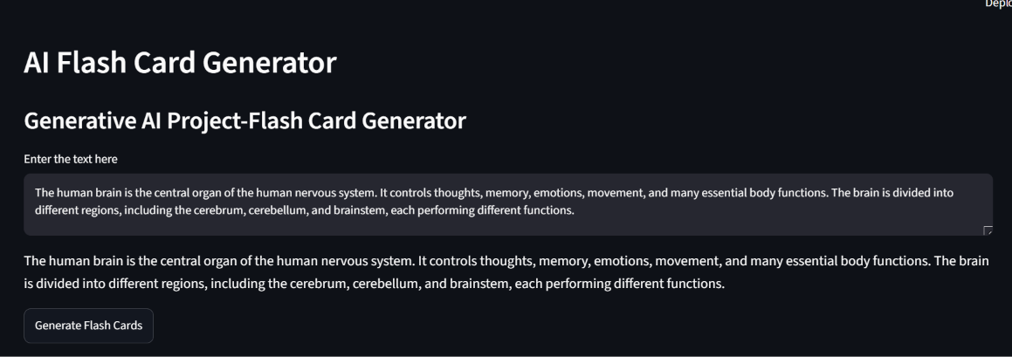
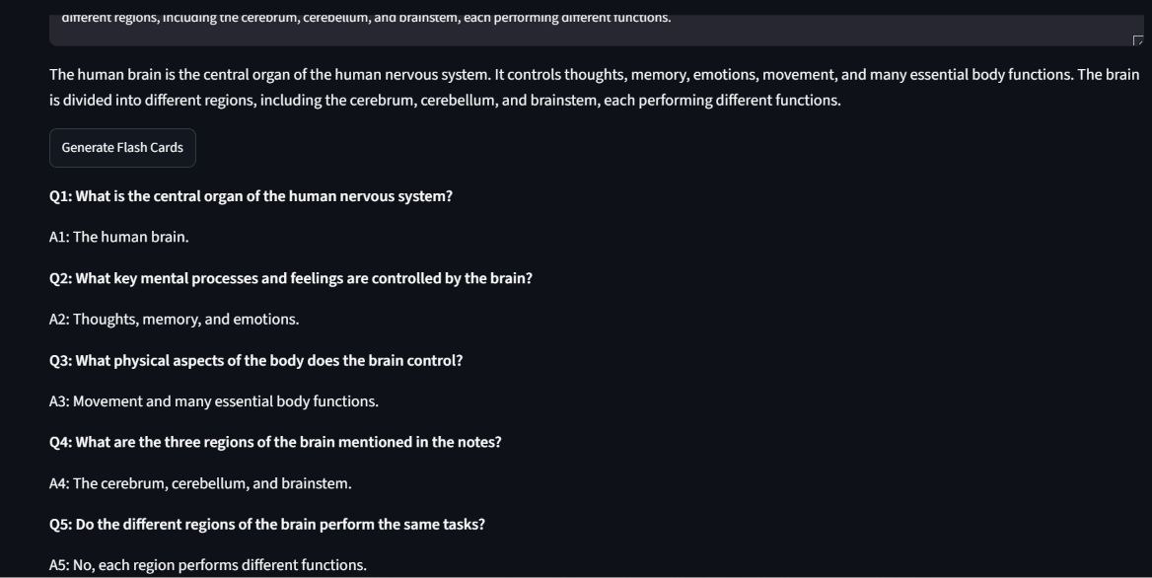
Result
Accepts study material from the user.
Sends the information to the Gemini model through a structured prompt
Generates five question-and-answer flashcards.
Displays the generated flashcards through the Streamlit interface.
Allows users to generate flashcards for different topics.

Slide 8
Conclusion
The AI Flash Card Generator provides a simple way to convert study material into question-and-answer flashcards using Generative AI. The project combines Python, Streamlit, and Google Gemini to create an interactive learning tool.
It reduces the effort required to manually prepare flashcards and can help students with quick revision of different topics.
Challenges: The system depends on internet connectivity and access to the Gemini API for generating responses.

Slide 9
Future scope
The project can be further improved by adding:
Custom number of flashcards — Allow users to choose 5, 10, 20, etc.
Difficulty levels — Easy, Medium and Hard questions.
Multiple input formats — PDF, DOCX and images.
Subject selection — Science, Mathematics, History, etc.
Save flashcards — Allow users to save generated flashcards.
Quiz mode — Convert flashcards into interactive quizzes.
Multiple languages — Generate flashcards in different languages.
Online deployment — Make the application accessible through a public web link.

Slide 10
References
Google Gemini API Documentation
Streamlit Documentation
Python Documentation
Google Generative AI Python Library Documentation
GitHub
The Python Standard Library — Python 3.14.3 documentation

Slide 11
Deployment link / github link
Github Link: https://github.com/deepanshiagarwal580/AI-Flash-Card-Generator.git
Deployment: https://ai-flash-card-generator-lhtjv4ubq7cah8mrv4yqlj.streamlit.app

Slide 12
THANK YOU
Presented by~
Deepanshi Agarwal

